Slide 1
Practice 10: Relate ADDIE and CDIO Methodology

Slide 2
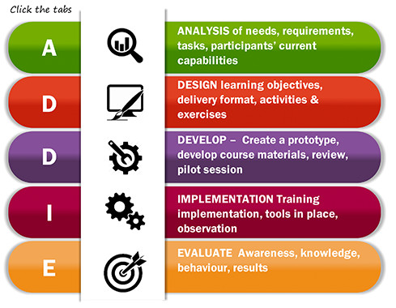
ADDIE Methodology

Slide 3
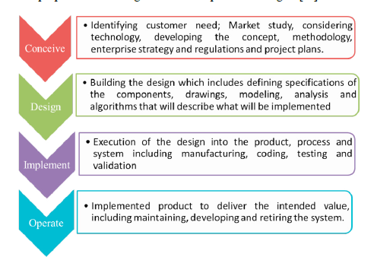
CDIO Methodology

Slide 4
Relate ADDIE and CDIO Methodology
 | Analysis | Design | Develop | Implementation | Evaluate
C | xzczxczx
D |  | zxczxvcxzv
I |  |  | zxzxczxvzx | zxvzxvzxvvx
O |  |  |  |  | zxczxvzxvx

Slide 5
Practice 11: Illustrate the Engineering Design Process for the given Application

Slide 6
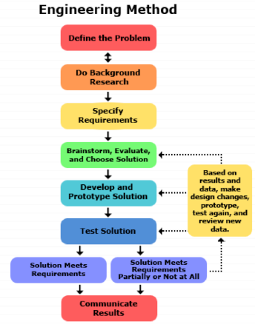

Slide 7
The Scientific Method | The Engineering Design Process
State your question | Define the problem
Do background research | Do background research
Formulate your hypothesis, identify variables | Specify requirements
Design experiment, establish procedure | Create alternative solutions, choose the best one and develop it
Test your hypothesis by doing an experiment | Build a prototype
Analyze your results and draw conclusions | Test and redesign as necessary
Communicate results | Communicate results
Steps of The Scientific Method | Steps of The Engineering Design Process

Slide 8
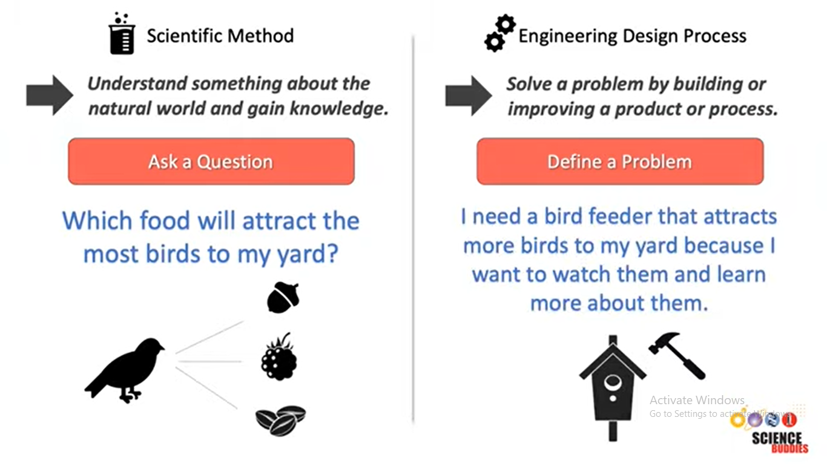

Slide 9


Slide 10
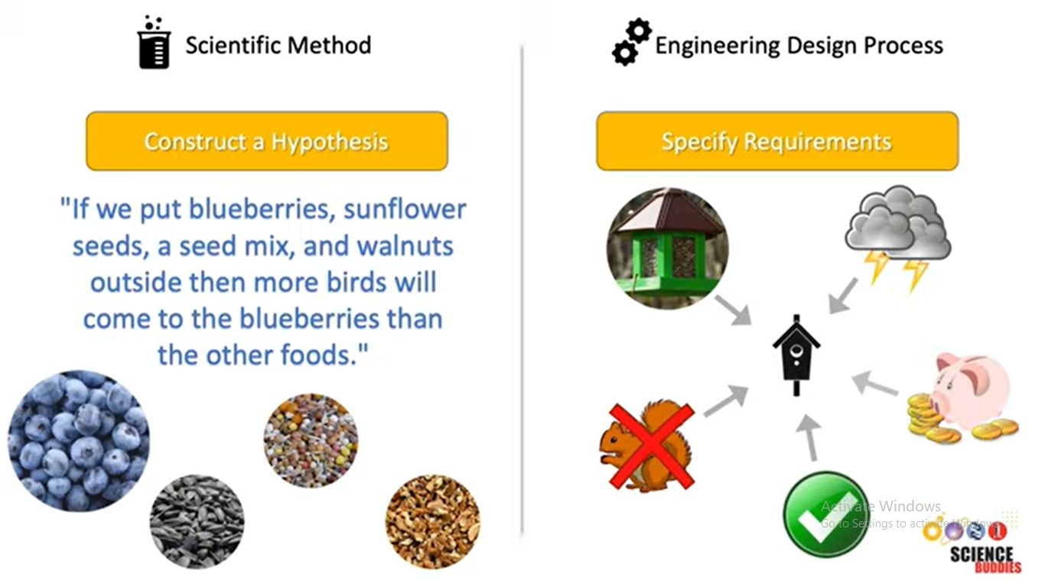

Slide 11
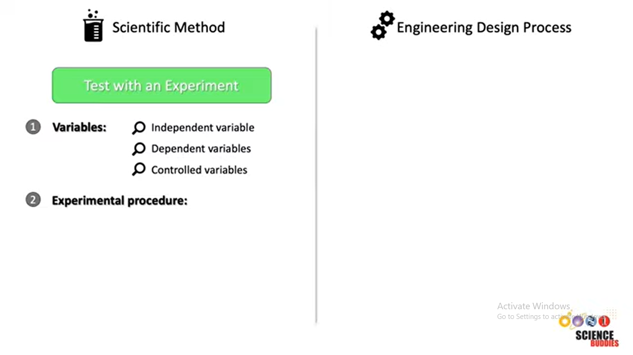

Slide 12
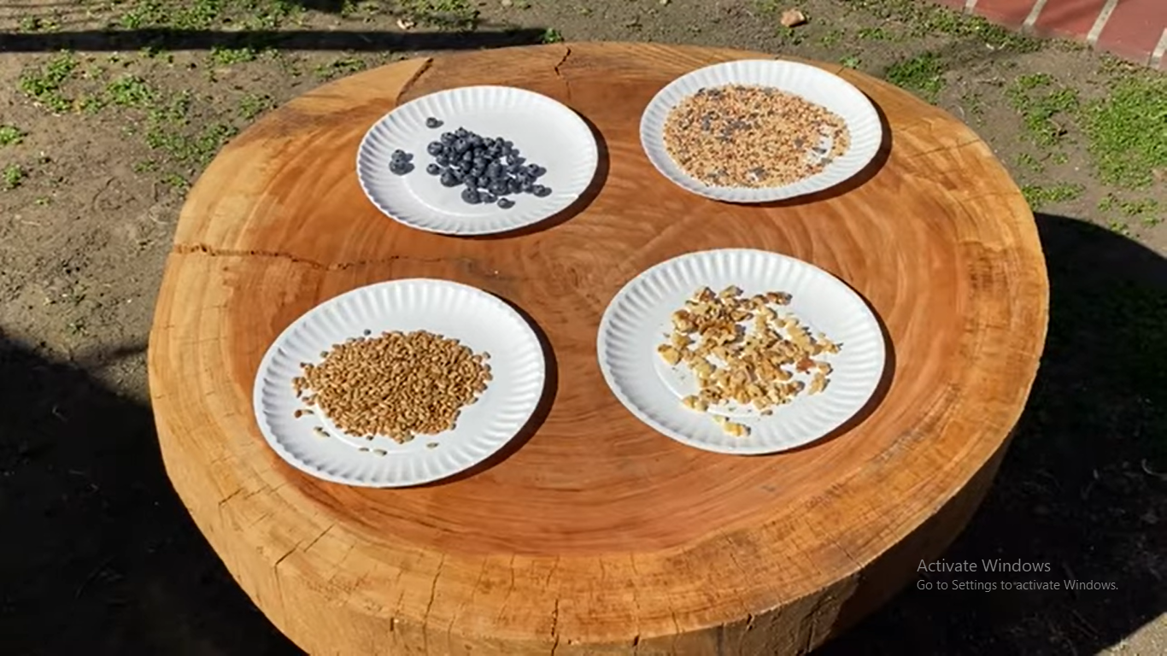

Slide 13
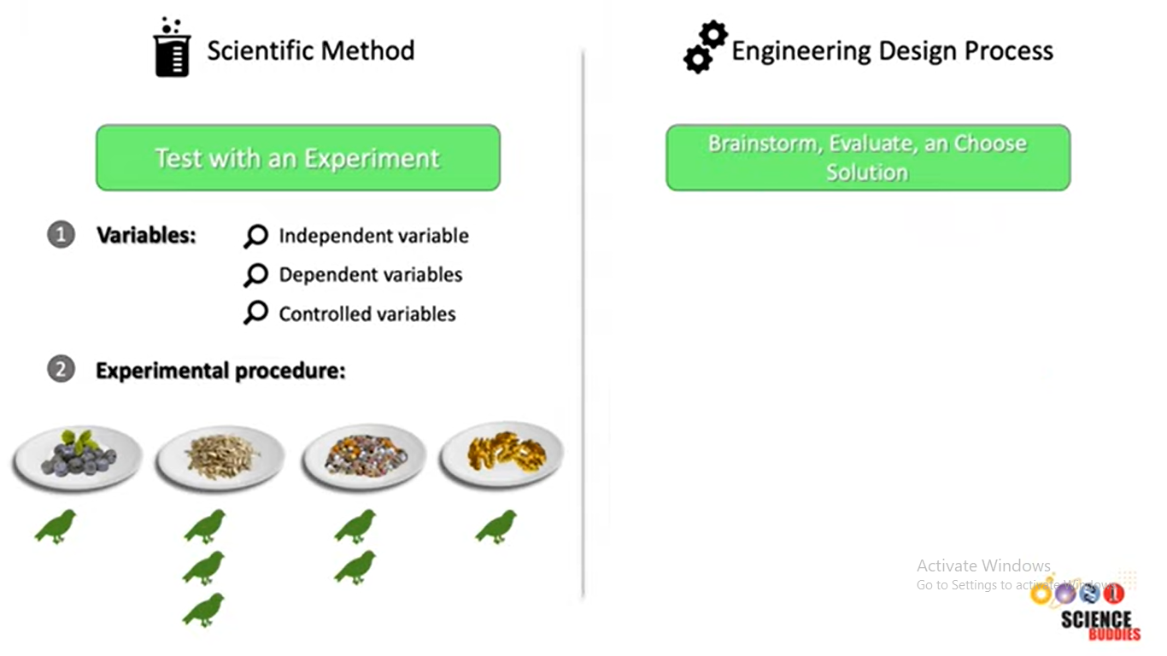

Slide 14
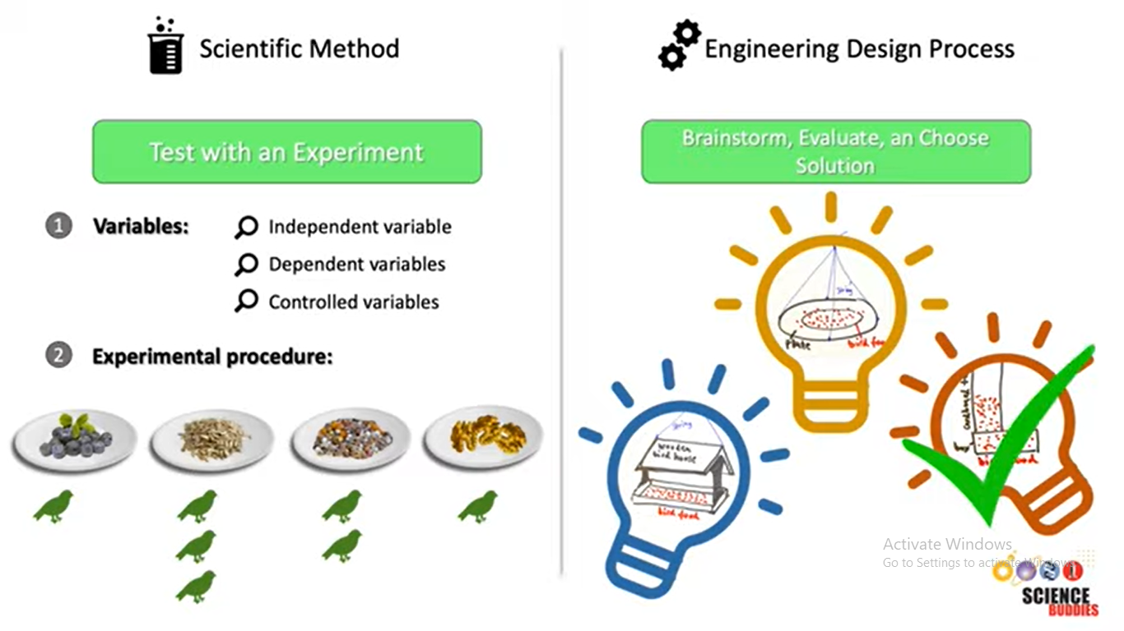

Slide 15
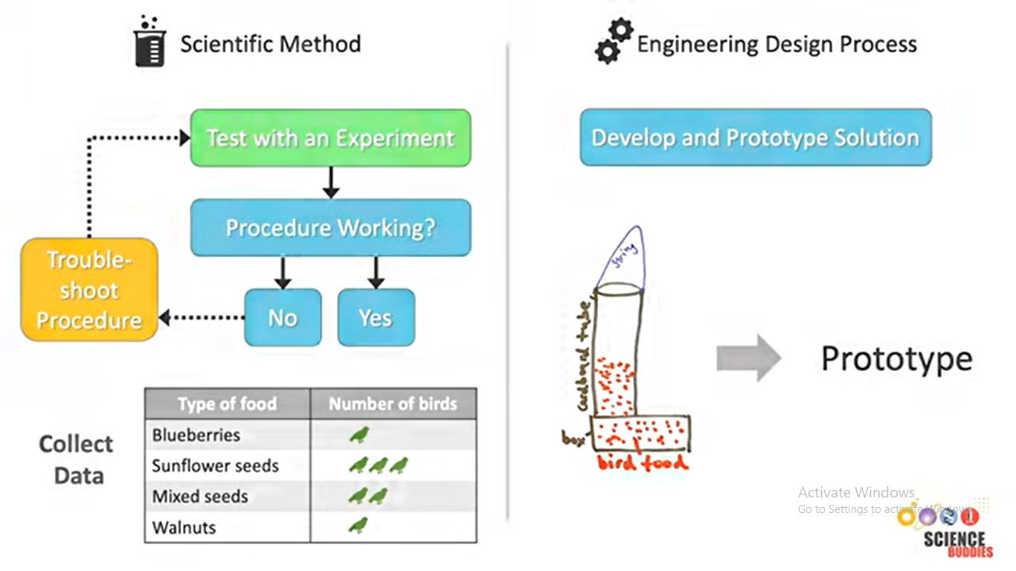

Slide 16


Slide 17
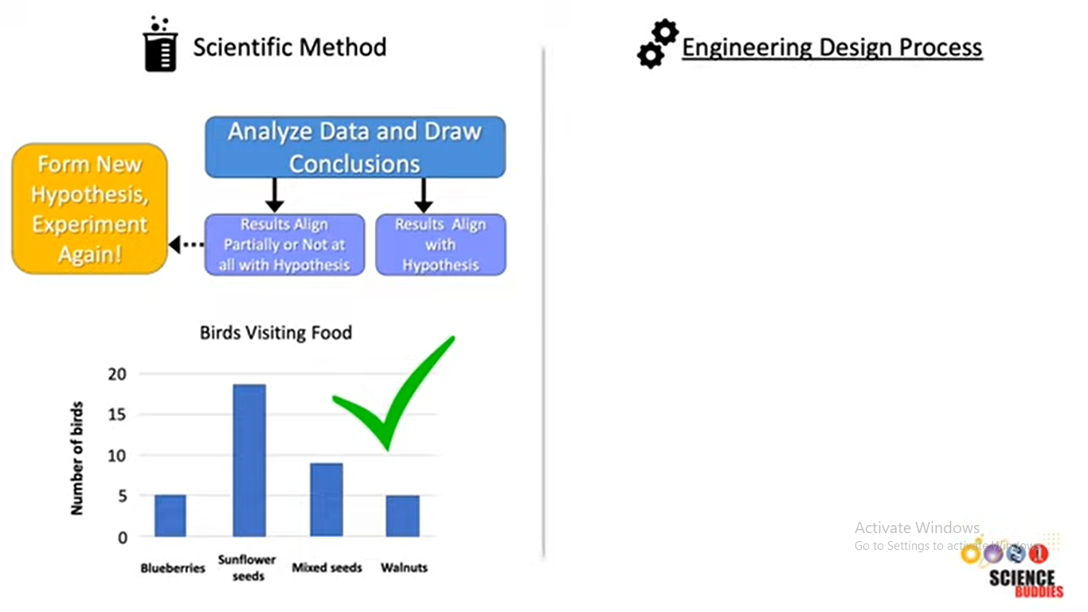

Slide 18


Slide 19
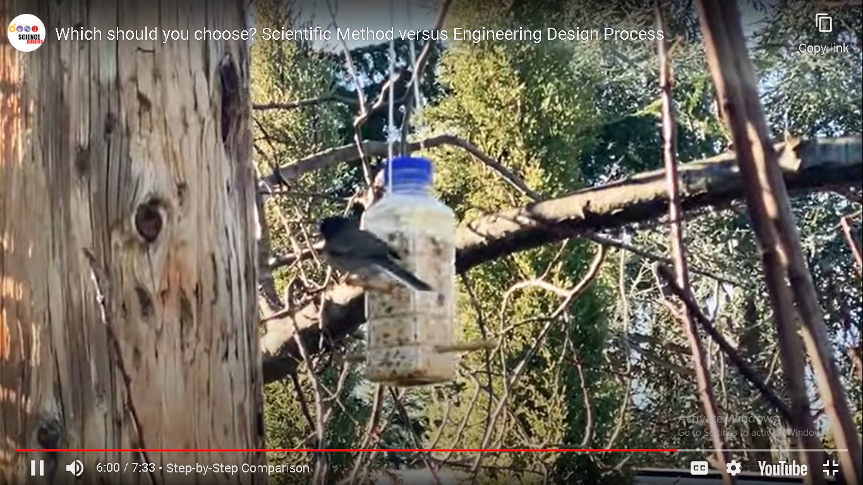

Slide 20
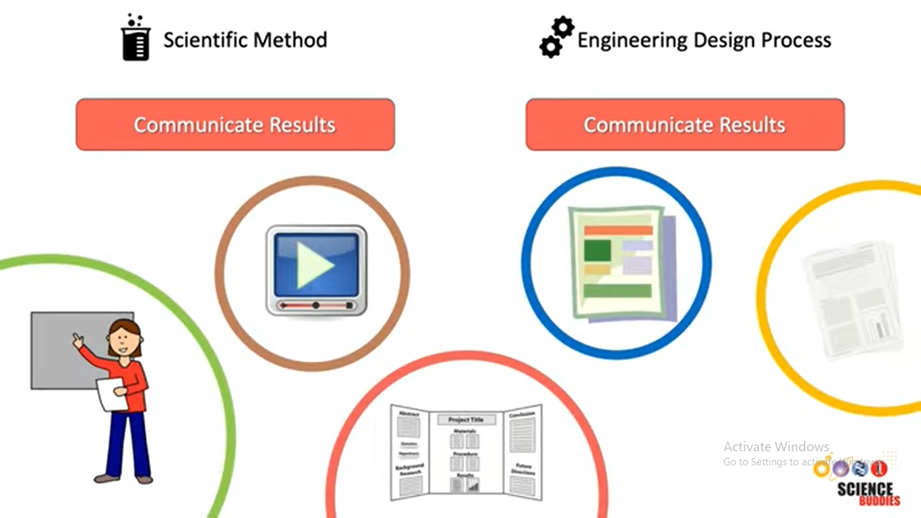

Slide 21
